Slide 1
PhysIQ
A Physical Reasoning Bechnmark for VLMs
By Massimo Stefan

Slide 2
Index
Introduction
Methodology
Experiments & Results
Conclusions & Future Work

Slide 3
Introduction

Slide 4
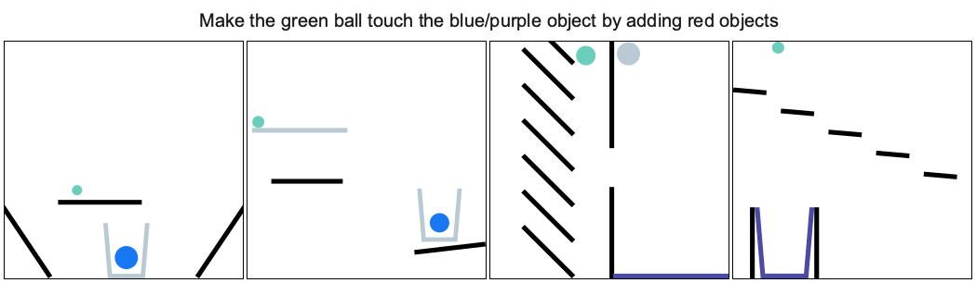
Physical Reasoning
🔮 Prediction and Understanding:
Anticipating interactions, dynamics, and outcomes based on causal relationships and physical laws.
🧠 Foundational Aspects:
Causal Reasoning: Differentiating between cause-and-effect relationships and superficial correlations.
Mental Simulations: Humans intuitively simulate scenarios internally to anticipate outcomes.
❓ Why It Matters in AI:
Essential for robotics, virtual assistants, and real-world interactive systems.
Ensures reliable predictions in real-world interactions beyond learned patterns.
“The ability to predict and understand the interactions, dynamics, and outcomes within physical environments, based on causal relationships and the laws of physics”

Slide 5
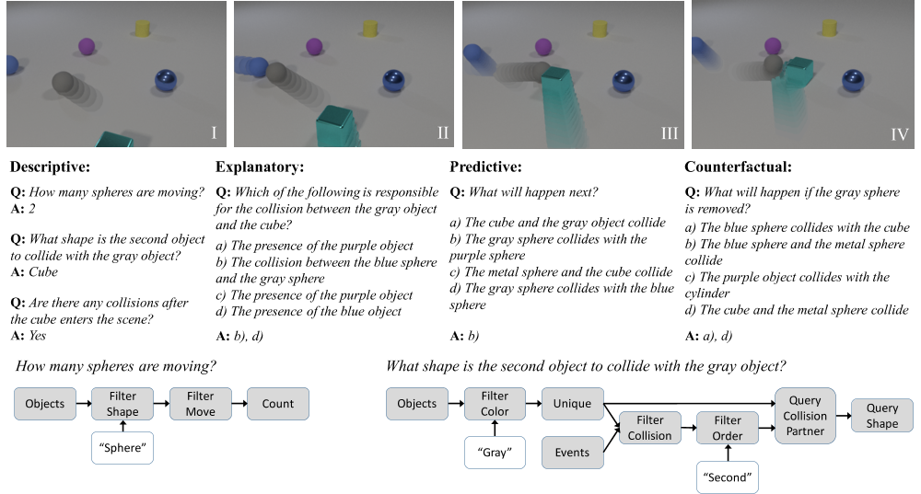
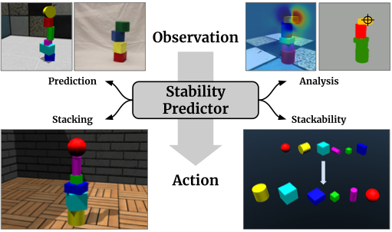
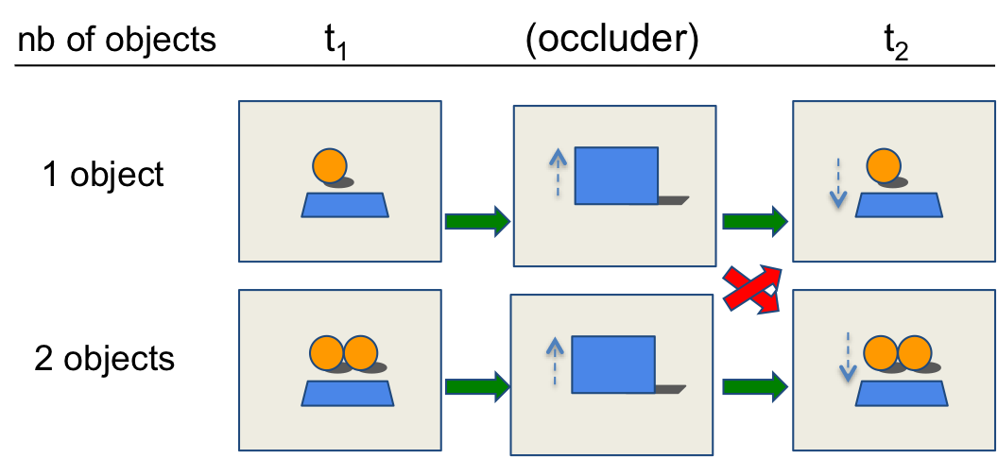
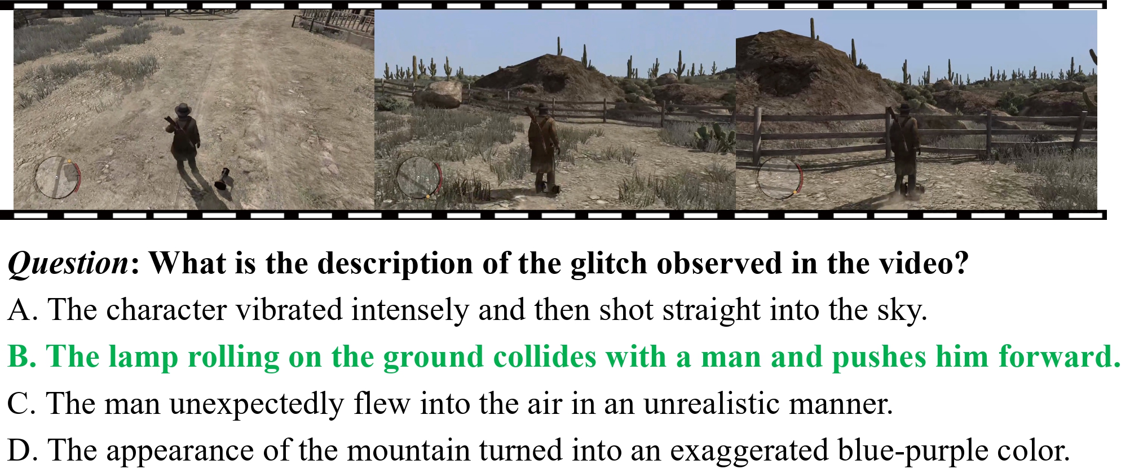
Several benchmarks
CLEVRER
PHYSGAME
INTPHYS
SHAPESTACKS

Slide 6
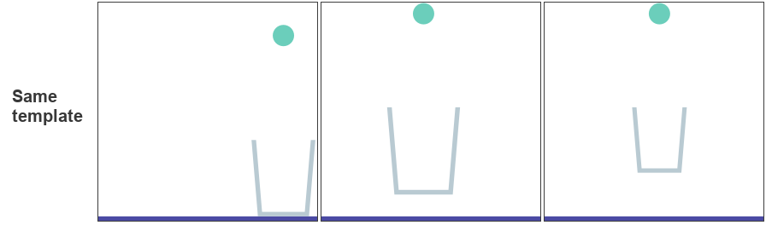
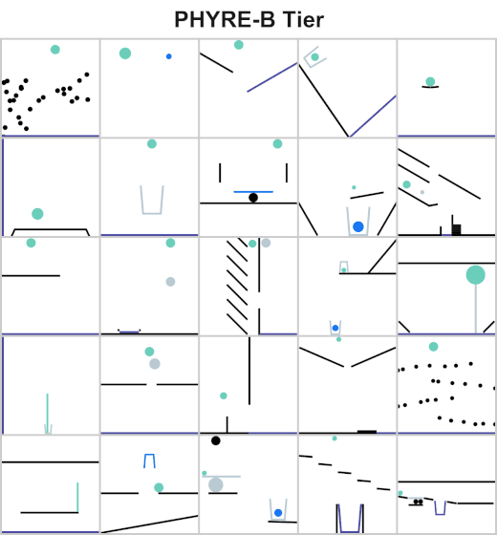
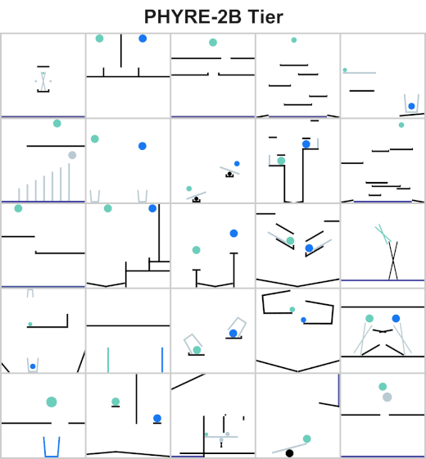
The PhyRE Dataset
# of samples:
25 “1 ball” templates
25 “2 balls” templates
100 Iterations per template
Total: 5000 different puzzles

Slide 7
PhysIQ: a PhyRE extension
📏 Measure the following abilities in the physical domain:
Understanding
Confidence
Prediction
Comparison
Interactivity
✅ Pros:
Extensible
Customizable
Offline & Interactive
2D
Simple for an LLM to act on

Slide 8
Methodology

Slide 9
Puzzles Bodies
Color: An integer index that maps to a specific color:
Red (0)
Black (1)
Green (2)
Azure/Blue (3)
Purple (4)
Grey (5)
Shape Type: Defines the geometric form of the body:
Polygon (0, 2): Defined by a set of vertices.
Circle (1): Defined by a center point and radius.
Compound (3, 4): Complex shapes composed of multiple polygons.
Position: The (x, y) coordinates of the body’s center within the scene.
Body Type: Determines the physics behavior of the object:
Static (0): Fixed objects that do not move during simulation.
Dynamic (1): Objects that respond to forces and collisions.
Angle: The rotation of the body in radians.
Relationship: Define the goal condition

Slide 10
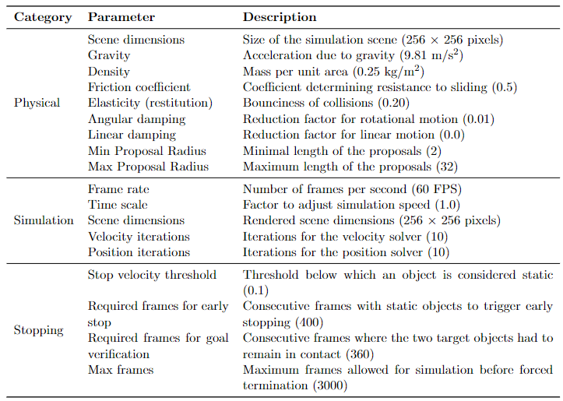
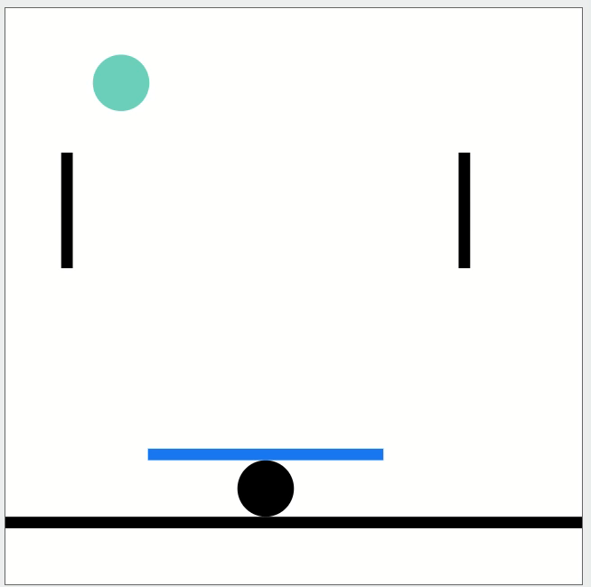
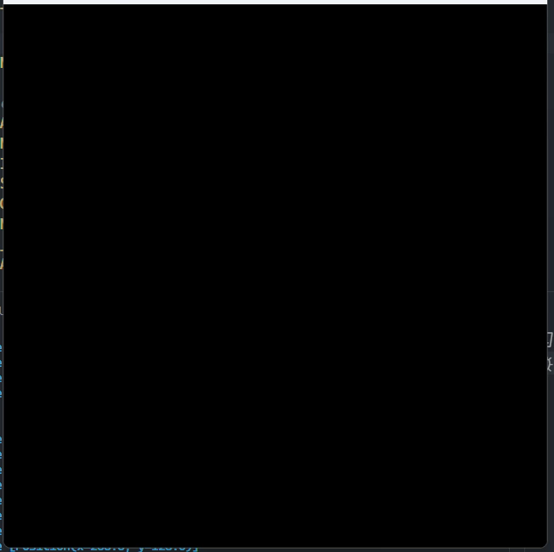
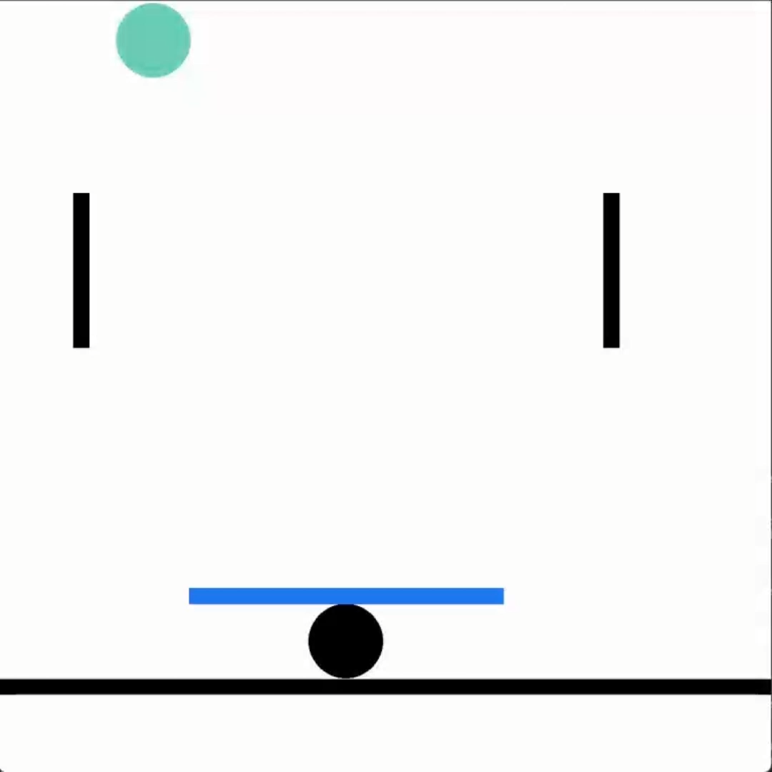
Simulation Constants
Original
Pymunk
PyBox2D

Slide 11
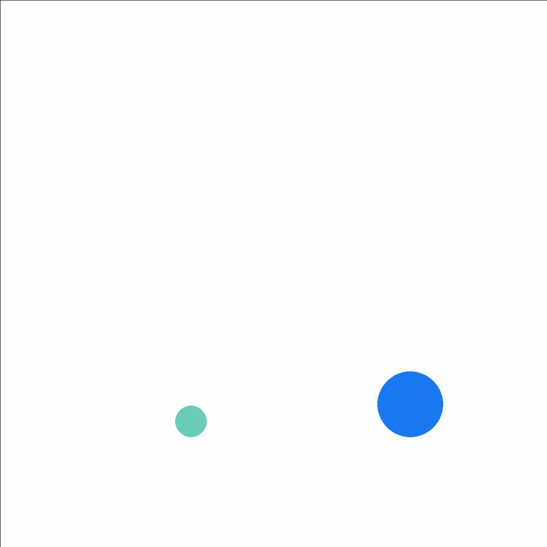
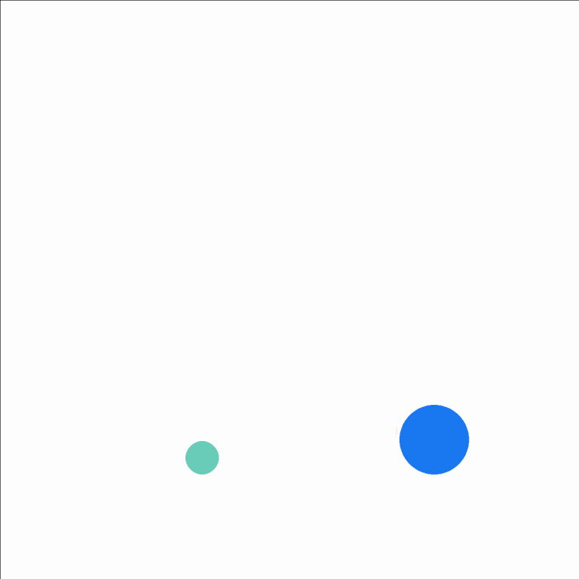

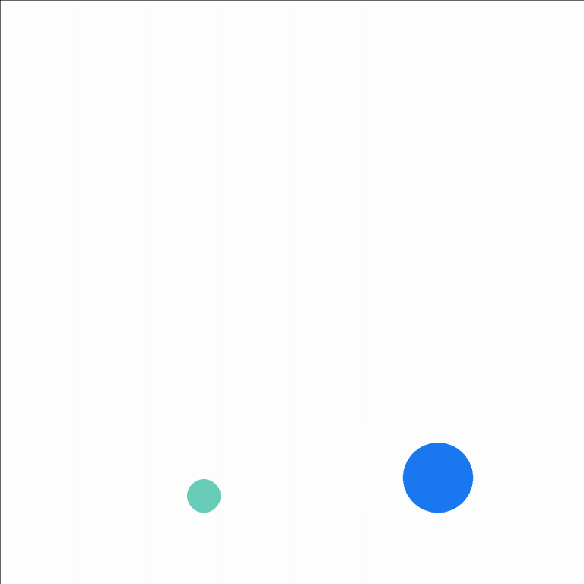

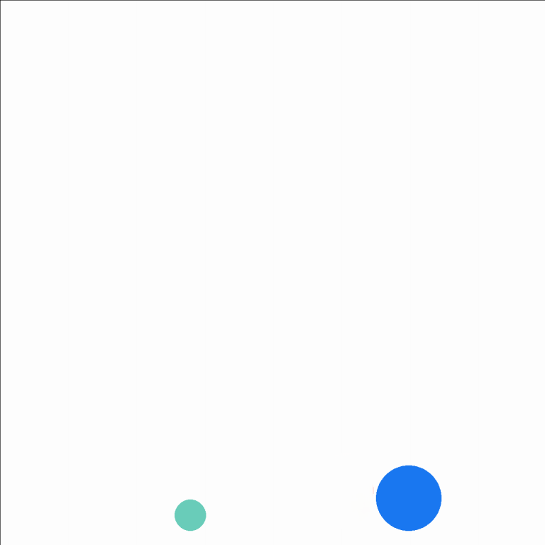


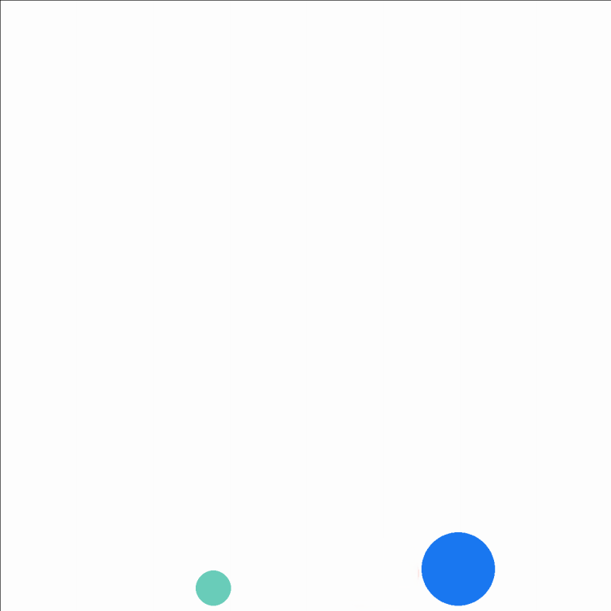
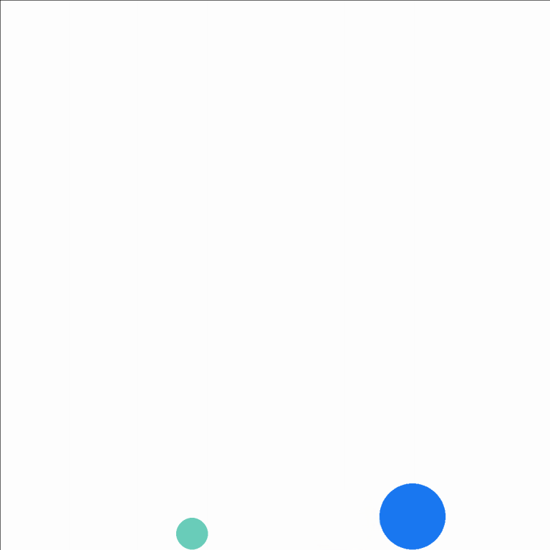








Simulation
Time Limit
Error
{
“bodies":[…],
“relationship": […],
“metadata":[…],
}
Win
Play
Puzzle JSON object
Stop
Screenshots

Slide 12
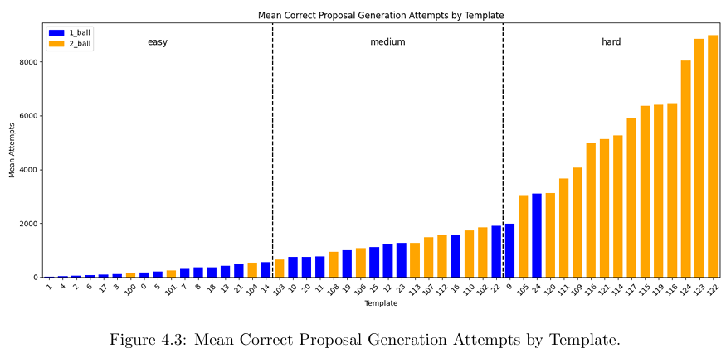
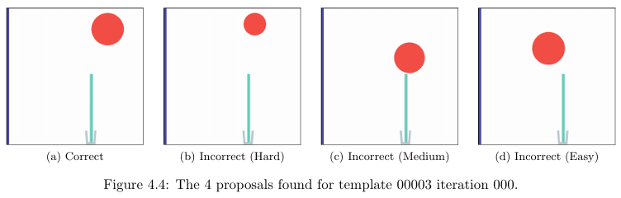
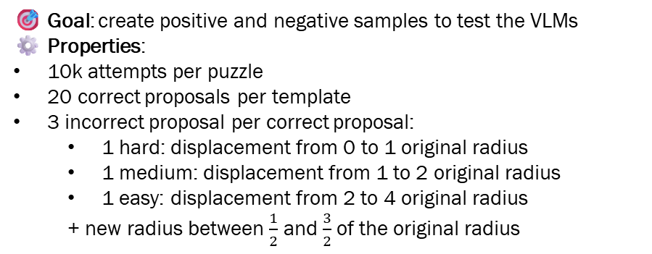
Proposals Identification
🎯 Goal: create positive and negative samples to test the VLMs
⚙️ Properties:
10k attempts per puzzle
20 correct proposals per template
3 incorrect proposal per correct proposal:
1 hard: displacement from 0 to 1 original radius
1 medium: displacement from 1 to 2 original radius
1 easy: displacement from 2 to 4 original radius
+ new radius between $\frac{1}{2}$ and $\frac{3}{2}$ of the original radius

Slide 13
Experiments & Results

Slide 14
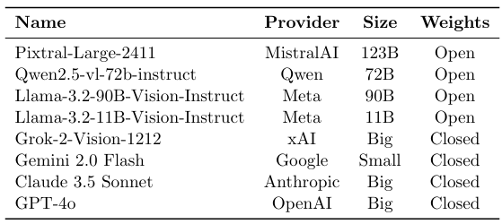
VLMs Evaluated
💰 To reduce the evaluation costs, we selected only the best performing VLMs for the harder challenges:
Sanity Check (8 VLMs)
Static Evaluations (4 VLMs)
Interactive Evaluation (2 VLMs)

Slide 15





Prompts design
…
Simulation conditions for all tasks:
Gravity: 9.81m/s²(downward)
Objects density: 0.25
Friction coefficient: 0.5
Elasticity coefficient: 0.2
Simulationduration:25 seconds or until objects stop moving
Black and purple objects: static (fixed)
Green, red, grey objects: dynamic (can move)
Goal criterion: Objects must remain in contact ≥ 3 seconds
Objects cannot leave the visible simulation boundaries
…
The prompts are always composed by:
A System message
Role (e.g. “…physics expert analyzing…)
Simulation parameters (optional)
Task description
Response format
Few-shot examples (optional) each composed by:
A User message with the example (randomly sampled)
An Assistant message with the correct response
A User message:
With the actual question
System prompt
…
Clearly define your solution by specifying:
”x”: horizontal position of the ball center (0 is left, maximum is 256 on the right)
”y”: vertical position of the ball center (0 is bottom, maximum is 256 at the top)
”radius”: size of the ball (minimum 2,maximum 32)
Important rules for placing the ball:
The ball must remain fully within the visible simulation boundaries.
The ball cannot overlap with existing objects.
…
User prompt
Assistant Answer

Slide 16
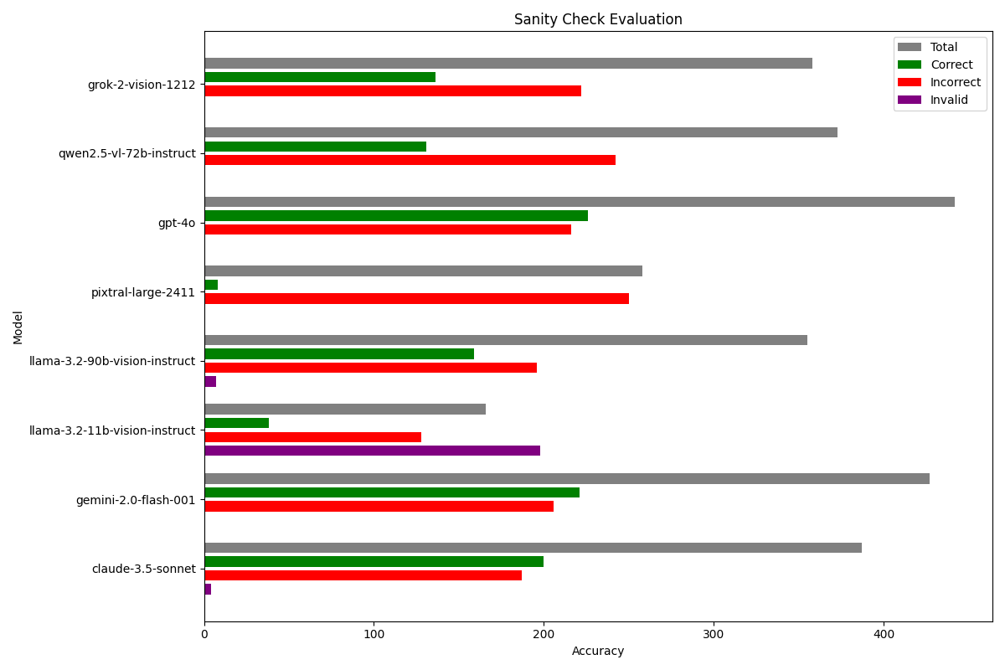
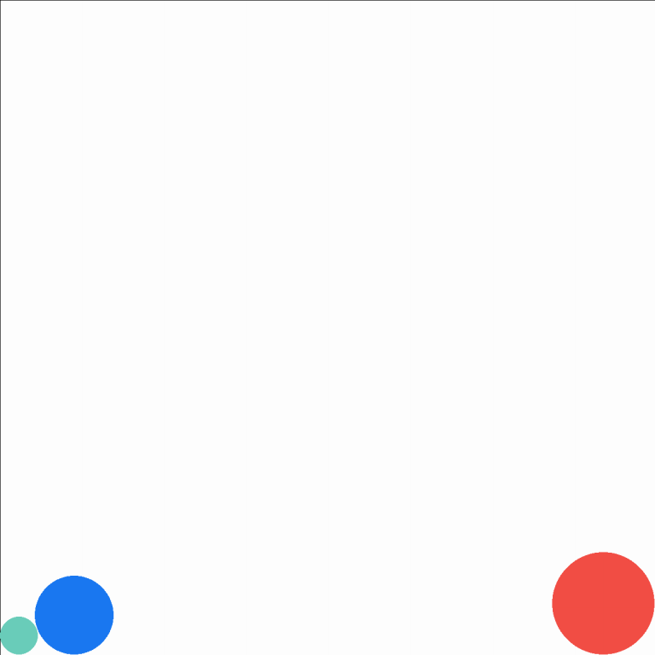
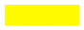

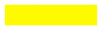

Sanity Check Evaluation
Are the target objects touching each other?
⚙️ Properties:
# samples per model: 5 correct & 5 incorrect proposals per template (500 total)
No few-shot examples
Only the 4 best performing VLMs proceed in the evaluation
Analysis?
Yes - No
🎯 Goal: determine weather the model can understand if the target objects are in contact or not
Notes:
Very low performance on inferring the goals reached
In llama 3.2-11b-vision the invalid responses were more than the number of correct attempts
Only llama models had invalid responses

Slide 17
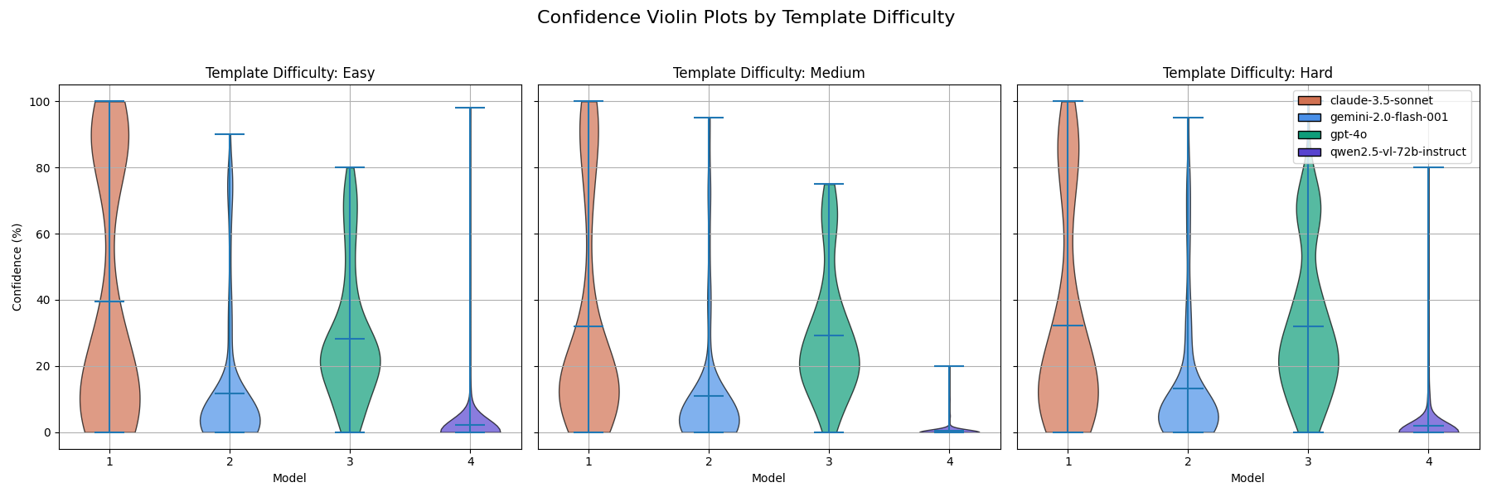
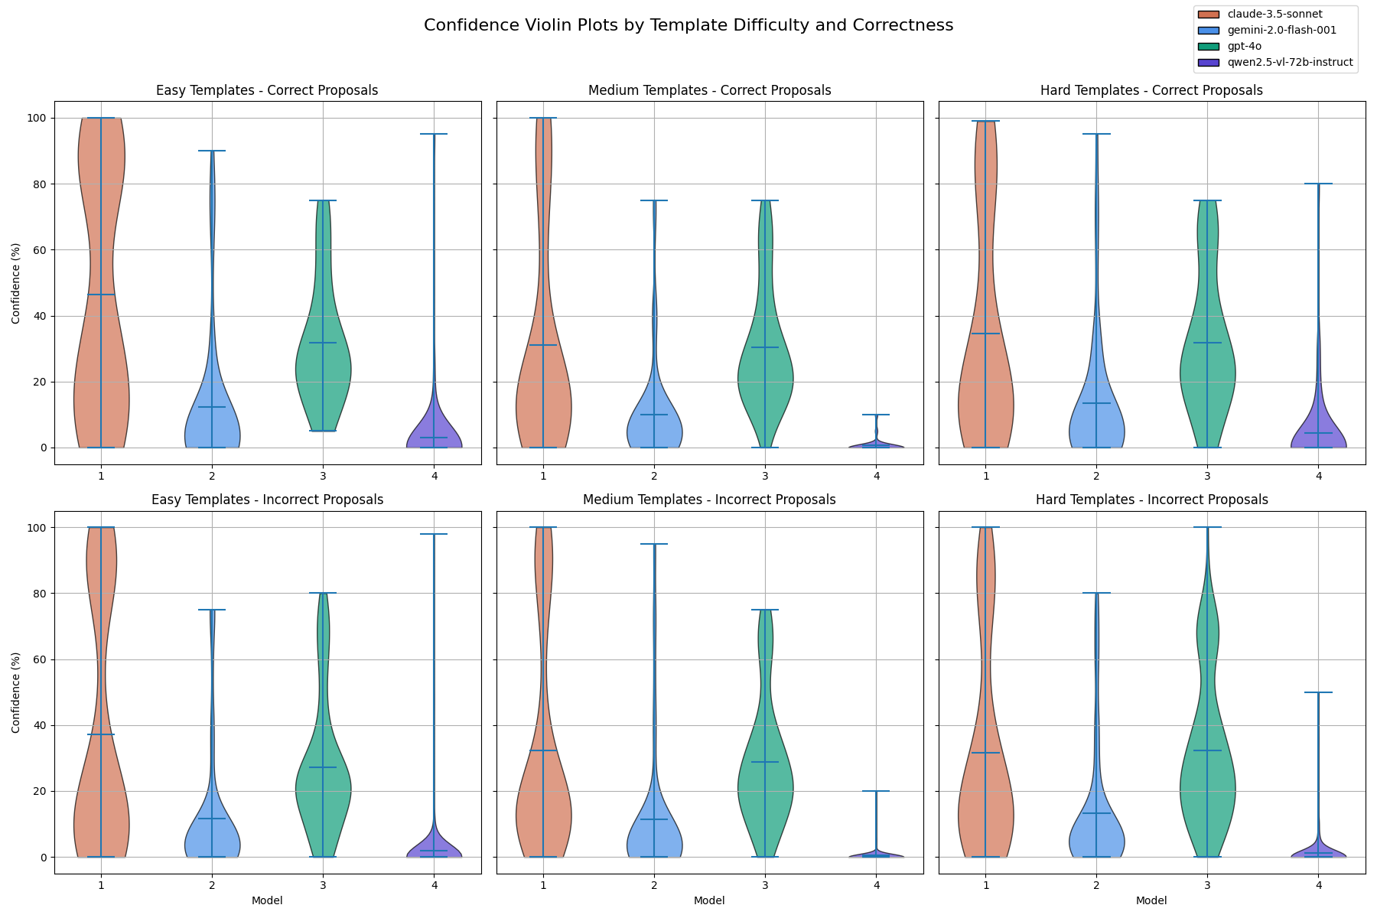
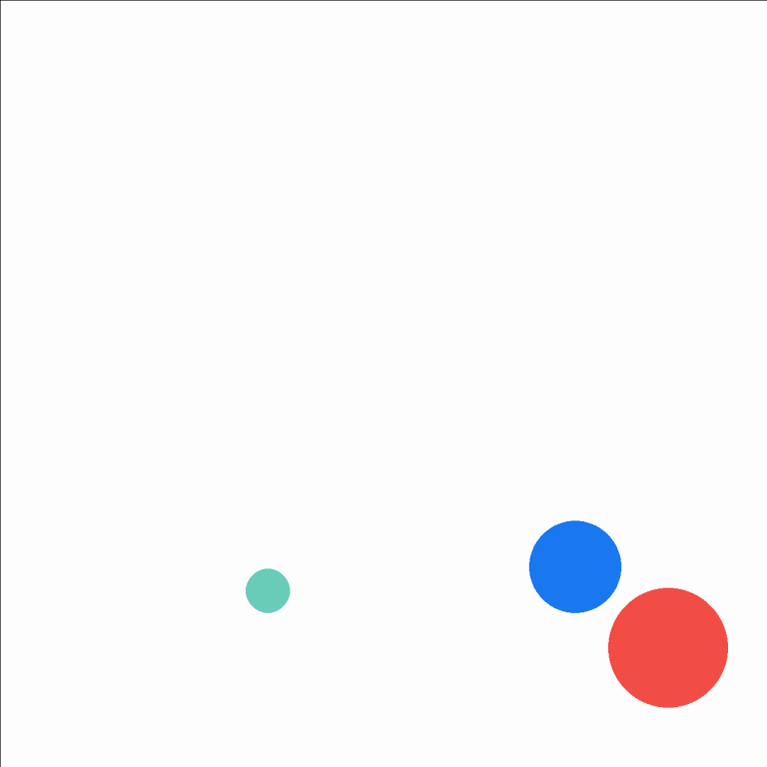
Confidence Estimation
What’s your
confidence the
goal is going to
be reached?
⚙️ Properties:
# samples per model: 3 sample per proposal type per template (600 total)
No few-shot examples
Confidence?
0% - 100%
🎯 Goal: attest the likelihood that a given proposal will succeed in the goal accomplishment
Notes:
Table 1
Claude and GPT-4o more uniform confidence, while gemini and gwen are underconfident
GPT-4o increase confidence on harder templates, while claude diminish
Claude always goes from 0 to 100%
Table 2
Claude higher confidence with the easy templates, in particular for the correct proposals
GPT-4o particularly confident on the easy correct proposal without ever betting under 8%
Same negativity for gemini and qwen in each other
Claude has the highest sensitivity towards template difficulty

Slide 18
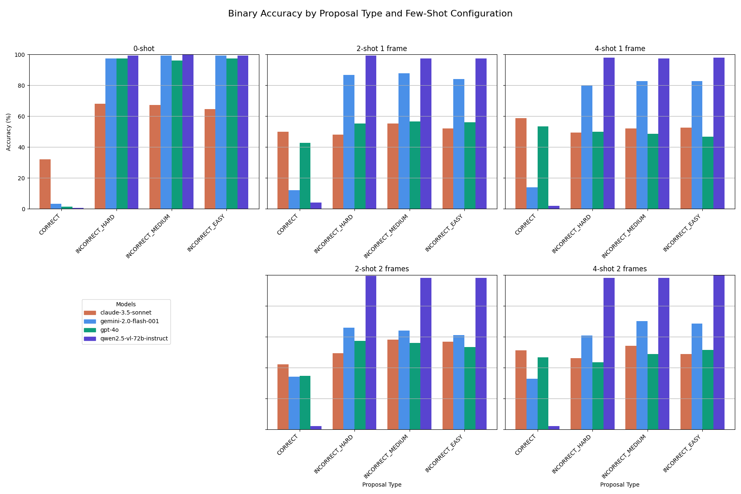
Binary Classification
Is the goal going
to be reached?
⚙️ Properties:
# samples per model: 3 sample per proposal type per configuration per template (3000 total)
0-, 2- and 4-shot examples, with 1 or 2 frames each
Prediction?
Yes - No
🎯 Goal: measure the predictions abilities with different types of contexts
Notes:
More examples, better accuracy
Claude higher “correct” accuracy also with 0-shot, the other models are negatively biased
Performance: claude, gpt-4o, gemini, qwen
Qwen strong bias towards negative response, even with additional examples
The 2 frames usually made the models underperform, only for gemini the performance is higher
Complementary patterns between correct and incorrect predictions

Slide 19
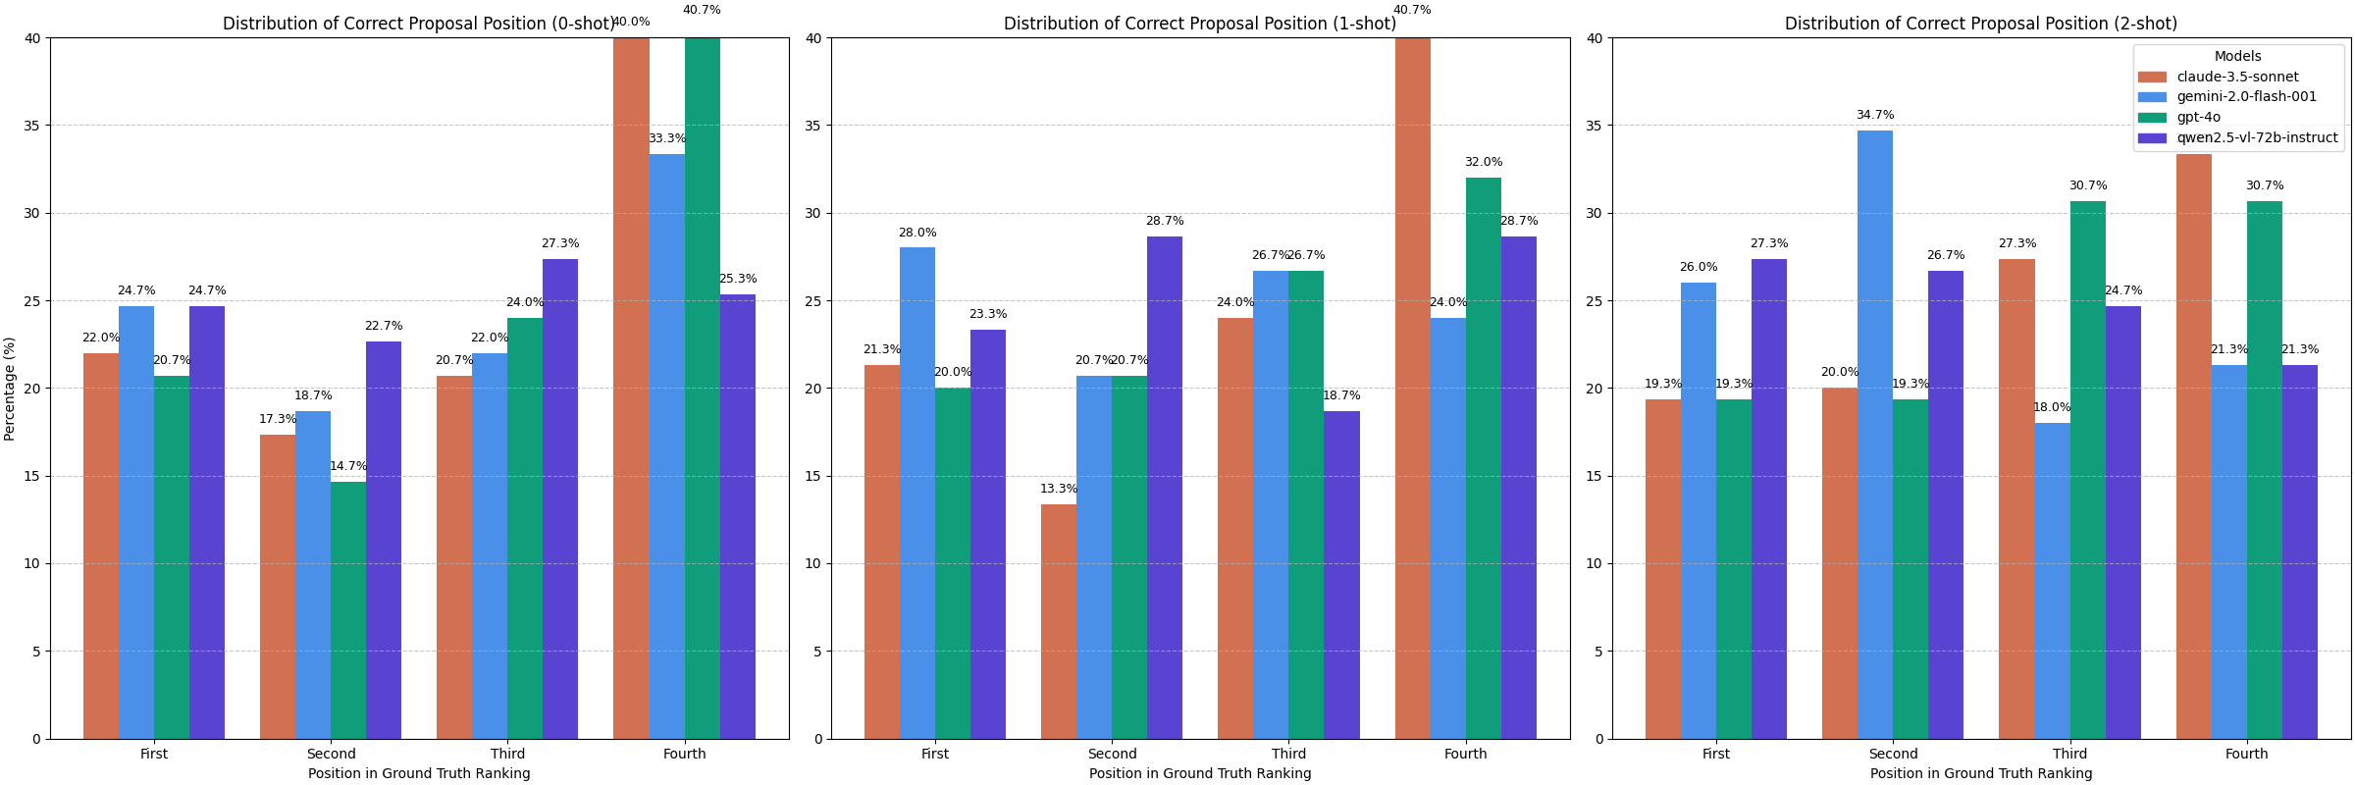
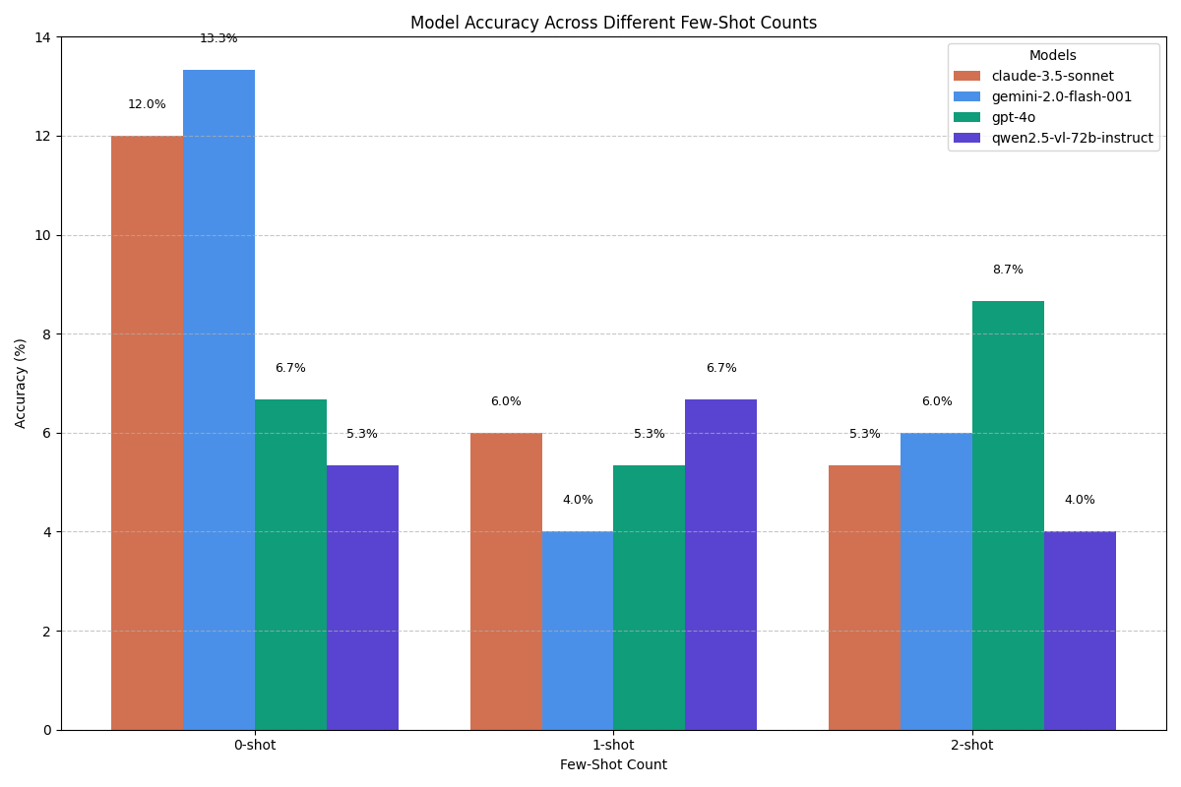
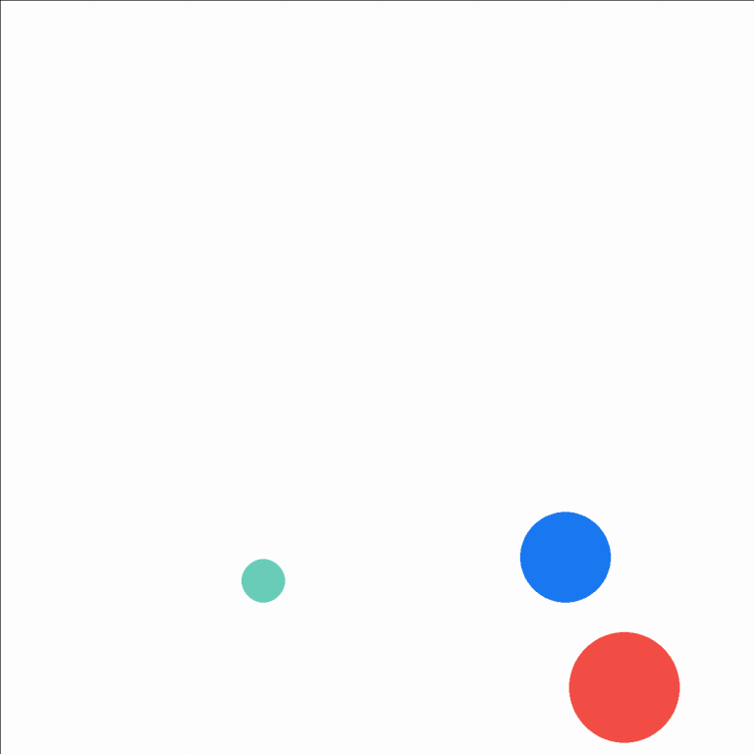
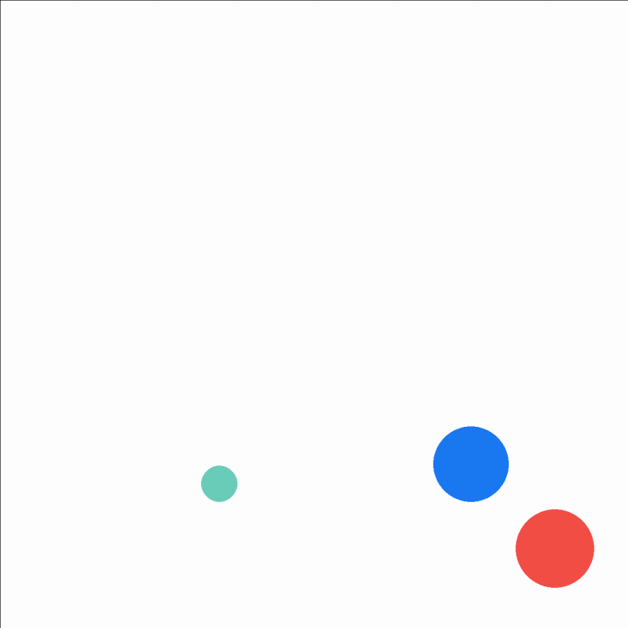
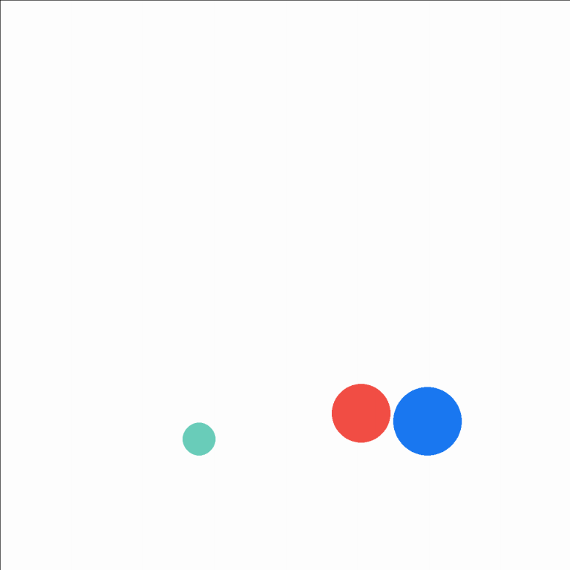
Ranking Task
What’s the proposal’s ranks from most to least likely to accomplish the
goal?
⚙️ Properties:
# samples: 3 samples per template per configuration (450 total)
0-, 1- and 2-shot examples
Comparison?
[1, 3, 4, 2]
🎯 Goal: determine weather the model can rank the proposals by their likelihood of successfully meeting the puzzle’s goal
Notes:
Very low accuracy, which decreases as the examples increase (between 4 and 13%)
Few-shot examples may confuse rather than help
Gemini-2.0-flash-001 and Claude-3.5-sonnet had marginally better zero-shot accuracy
Near-random distribution of rankings -> Models cannot reliably distinguish scenario quality.
Slight preference to position the correct proposal as the least likely to succeed
In general we see the inverse of the expected trend from an “aligned” model

Slide 20
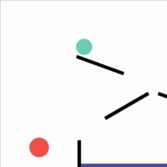
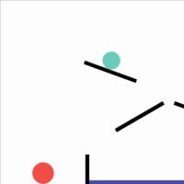
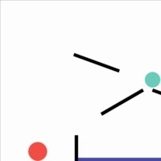
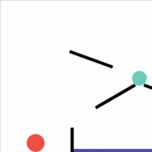
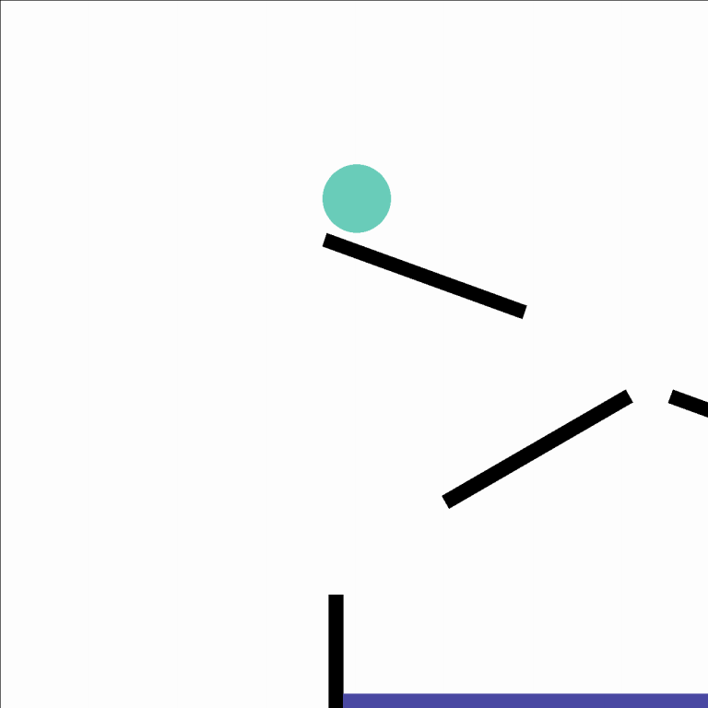

Interactive Insertion
Insert the
proposal in
order to reach
the goal.
Retry
Error
Stop
Time Limit
Try
5 attempts threshold
{
"x": 20,
"y": 45,
"radius": 10
}
Play
Win
Proposal Insertion

Slide 21
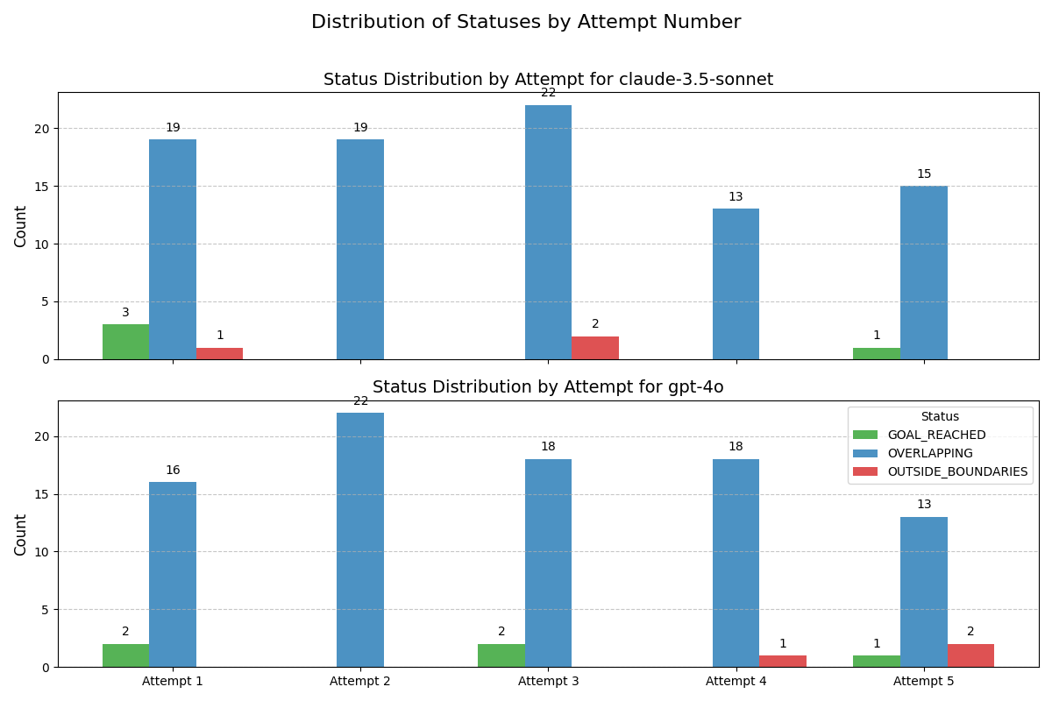
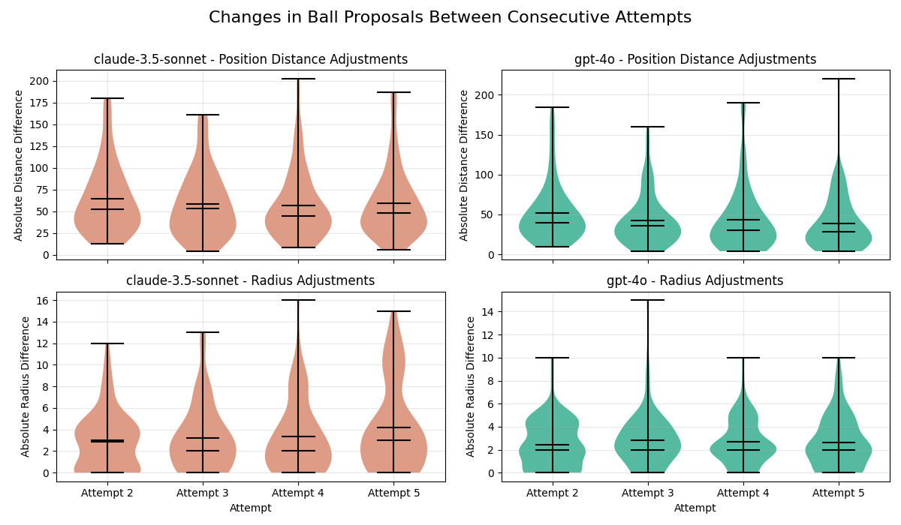
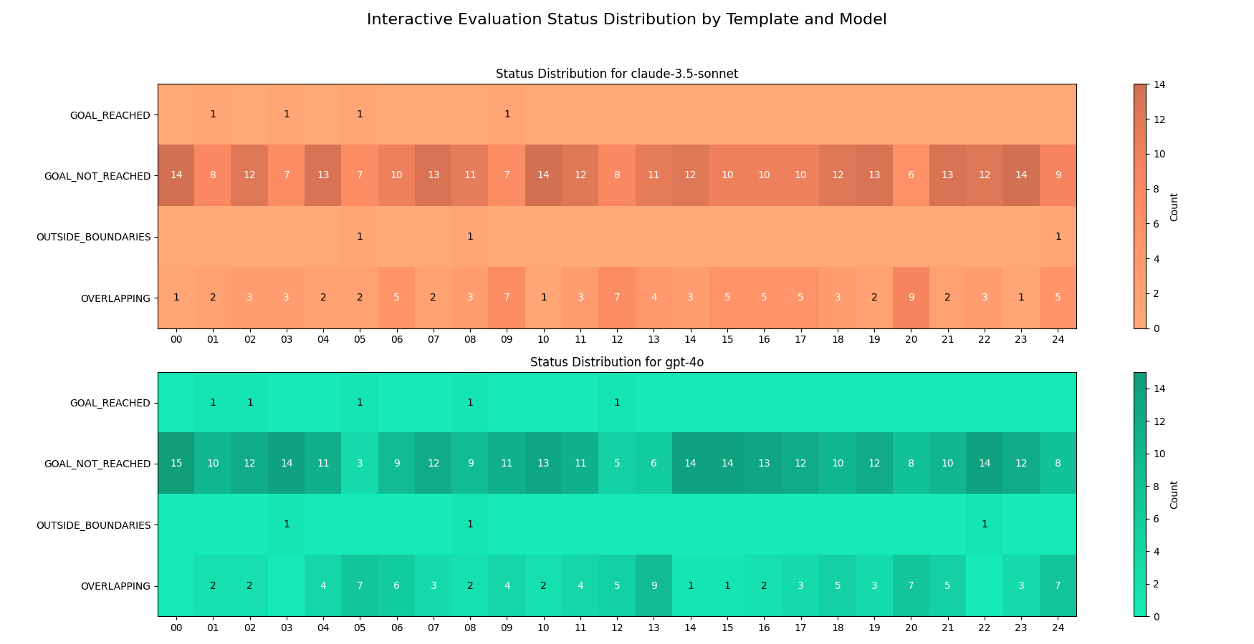
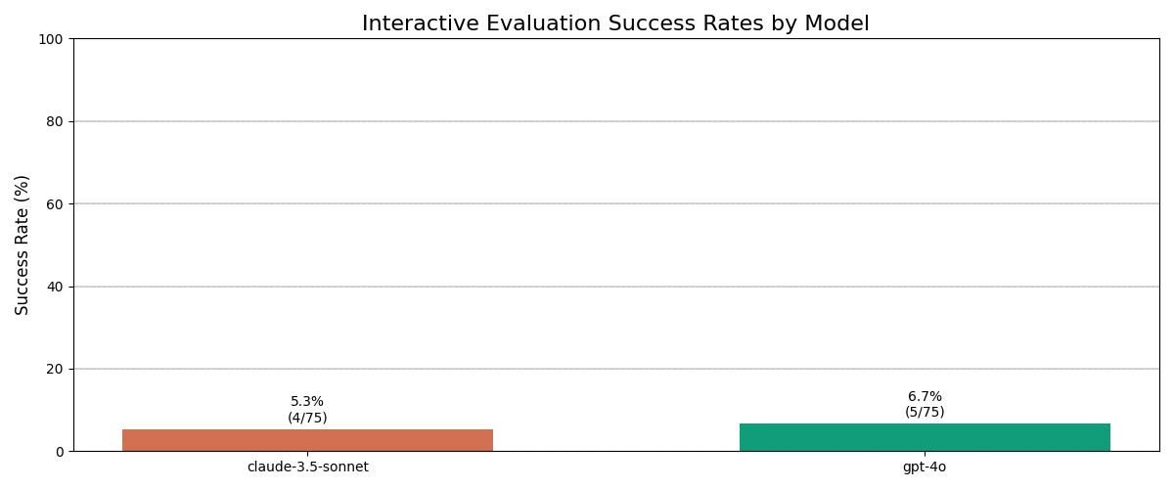
Interactive Insertion
Insert the
proposal in
order to reach
the goal.
⚙️ Properties:
# samples: 3 samples per template (150 total)
No few-shot examples
Try
{
"x": 20,
"y": 45,
"radius": 10
}
🎯 Goal: determine weather the model can ascertain if the target objects are in contact
Notes:
Table 1:
General low success rate
Models generally fail to effectively differentiate multiple physical scenarios, either because
Table 2:
A lot of overlapping, specifically in some more crowded templates
Most of the times the goal is simply not reached
The wins are scattered, but mostly on simpler puzzles
Table 3:
No performance increase in later attempt
Overlapping quite distributed
Table 4:
Small positions and radius changes, but a change in position generally occurred
Claude tend to make bigger jumps between attempts

Slide 22
Conclusions & Future Work

Slide 23
Main results
Baseline Physical Perception
The more advanced models demonstrated basic competence in identifying whether objects are in contact
Confidence & Calibration
Confidence estimation weakened with increasing puzzle complexity
Binary Classification & Biases
Strong biases and significant improvement for Claude and GPT-4o with few-shot examples
Ranking & Comparative Reasoning
All models struggled, and adding examples didn’t improve the performance
Interactive Evaluation
Very low success rate, with frequent spatial errors (overlapping)
🔑 Takeaway: Current VLMs rely largely on learned correlations and struggle significantly with deep, iterative physical reasoning tasks

Slide 24
Future work
More Diverse Goals
Extend to 3D Environments
Real-Time Interaction & Extended Trials
Hybrid Approaches
Enhanced Prompting & Evaluation
Benchmark Expansion
Comparisons with Human Performance
…
🎯 Goal: To create a robust, comprehensive benchmark that effectively measures true causal understanding and intuitive physics capabilities in AI systems.

Slide 25
Thank you
Made under the supervision of:
Raquel Fernández (UvA)
Alberto Testoni (UvA)
David Shlangen (University of Postdam)
Jacopo Staiano (UniTN)
Roberto Dessì (FBK)

